Slide 1
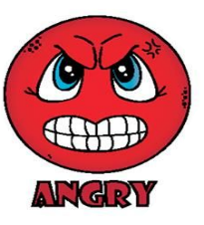



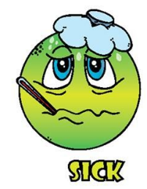
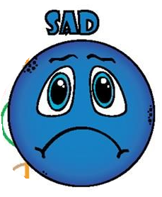
I’m …
Hello!
HOW are you today?

Slide 2
That’s excellent!!!

Slide 3
Oh! Count to 10 and
get relaxed...

Slide 4
Yeah! Congrats!
And who are you in love?

Slide 5
Ouh! You are a great person!
Be strong!

Slide 6
Ouh! You should take care and get some rest

Slide 7
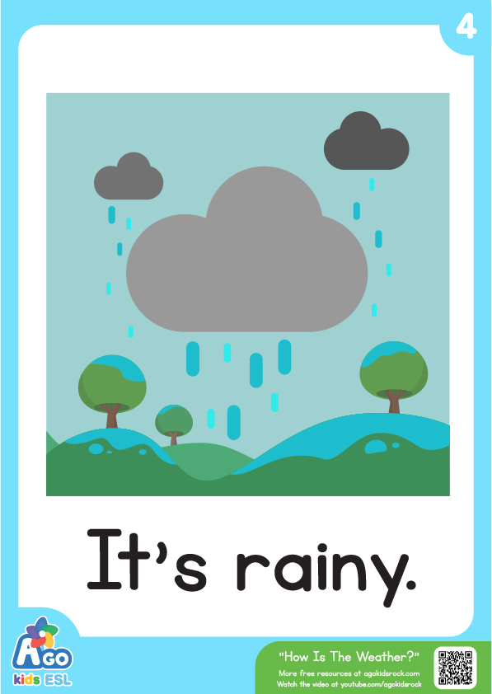
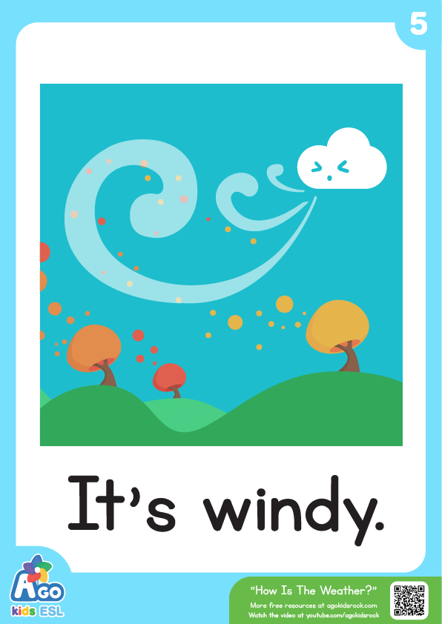
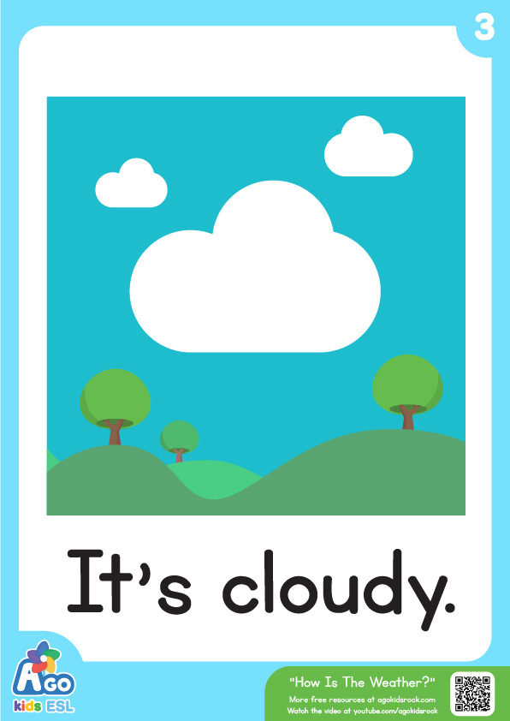

What’s the WEATHER today?
sunny.

Slide 8
Copy on your notebooks
Para referirnos a las cosas que nosotros u otras personas tienen, utilizaremos el verbo HAVE (tener).
Este verbo se puede conjugar dependiendo de quien estamos hablando.
REMEMBER!
To refer to your or others’ possessions:
(Recordar!)
1.-
Have / Has = Tener
2.-
Have = Have got = Tener
Has = Has got = Tener
3.-
I have got = I’ve got = Yo tengo
She has got = She’s got = Ella tiene
He has got = He’s got = Él tiene

Slide 9
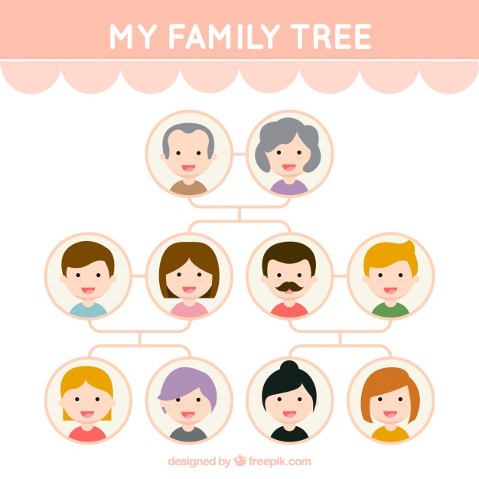
Remember!
GRANDPA
GRANNY
FAMILY MEMBERS
NIECE:
Sobrina
NEPHEW:
Sobrino
DAD
MUM
UNCLE
AUNT
SISTER
BROTHER
COUSINS

Slide 10
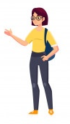
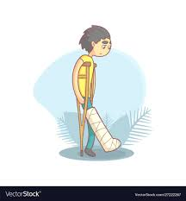
EXAMPLE!
I’VE GOT ONE (1) BROTHER AND MY MUM
SHE’S GOT ONE LITTLE BROTHER

Slide 11
Copy on your notebooks
(Copiar en tu cuaderno)
REMEMBER!
To know about others’ mood, you can ask:
(Recuerda!)
How are you (today) = Como estás (hoy)?
- How do you feel (today) = Como te sientes (hoy)?

Slide 12
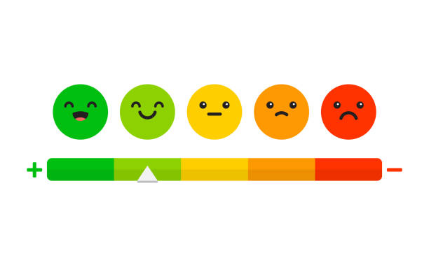
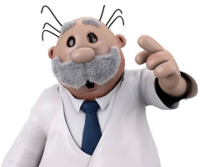
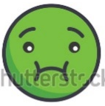
How do you feel today?
Copy on your notebooks
I feel excellent!!
I feel nice!
I feel not so good
I feel bad
I feel sick
I feel terrible

Slide 13
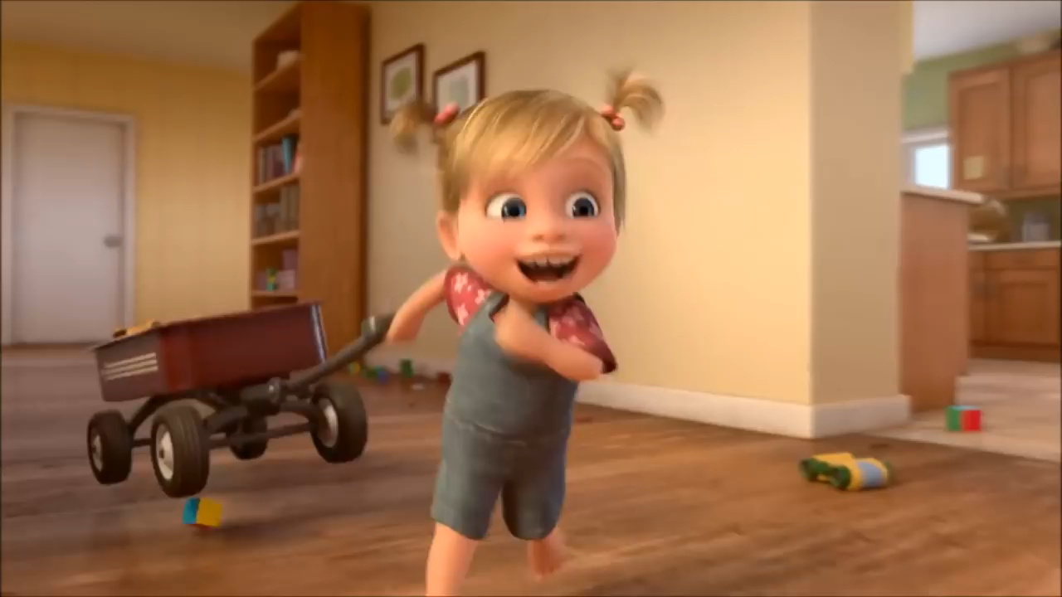
Watch the video and enjoy! ☺

Slide 14
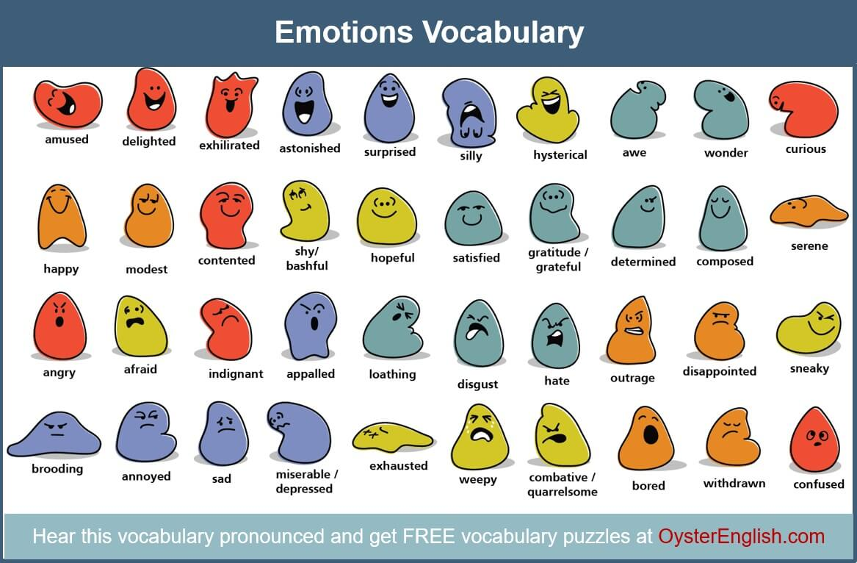

EMOTIONS
Copy on your notebooks. Search the meaning in spanish
HAPPY
SAD
SILLY
ANGRY
NERVOUS
EXCITED
WORRIED
TIRED
BORED
LOVING

Slide 15
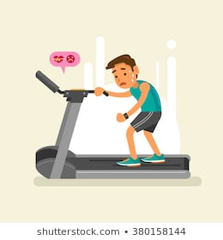
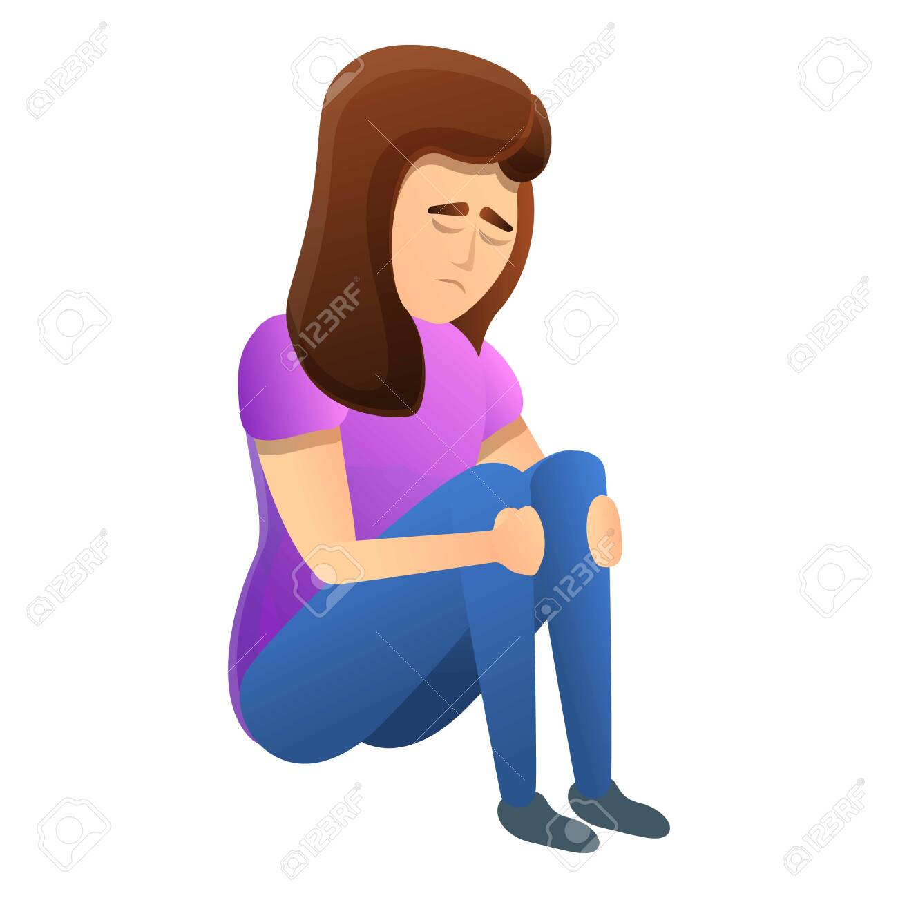
To describe emotions:
I’m = Yo estoy
She’s = Ella está
He’s = Él está
I’M HAPPY
SHE’S SAD
HE’S TIRED

Slide 16
Let’s move to the worksheet
(Vamos a la guía)

